Slide 1


Introduction to Materials Property Prediction
Dane Morgan, Ryan Jacobs (University of Wisconsin - Madison, Wisconsin, USA)
Ben Afflerbach (Fort Lewis College, Colorado, USA)
Part of TMS Online Course: Artificial Intelligence and Machine Learning
Part of Module 3: Approaches to Materials Property Prediction with Machine Learning
October 27-29, 2025

Slide 2
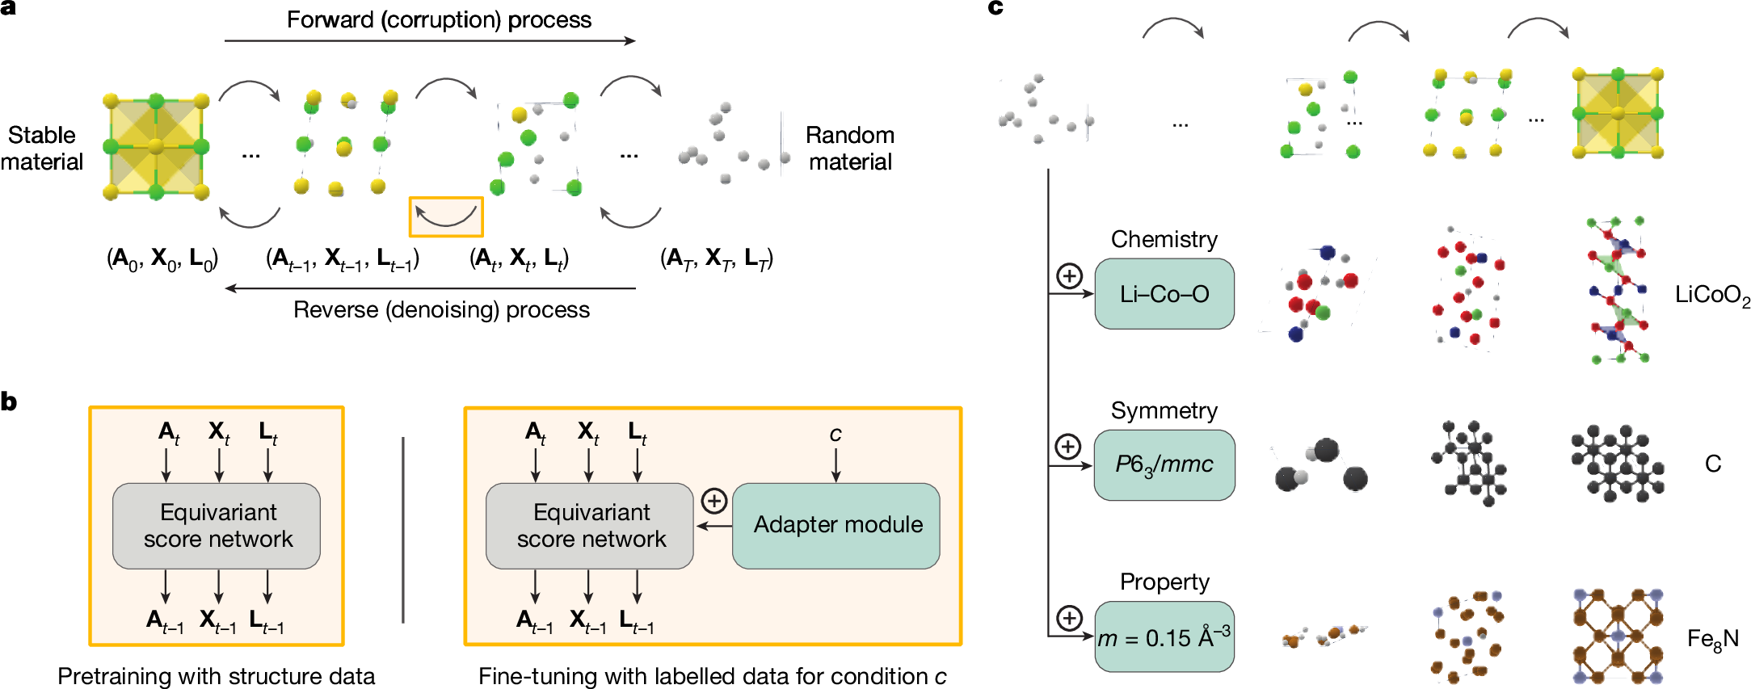
Moving Beyond Regression to Generative
Generative machine learning on materials structures does 2 things
Generates a candidate materials structure
Predicts properties of that structure
Generative step adds a whole additional machine learning challenge.
Powerful for finding new materials with new properties
Example of the MatterGen approach.
Generates likely stable structures that also have target properties.
Trained on large existing structural databases for structure generation and then can be fine-tuned for specific property. We will tune for Na-ion battery cathode voltages (Sec 3).
Zeni, C., et al. Nature 639 (2025). https://doi.org/10.1038/s41586-025-08628-5

Slide 3
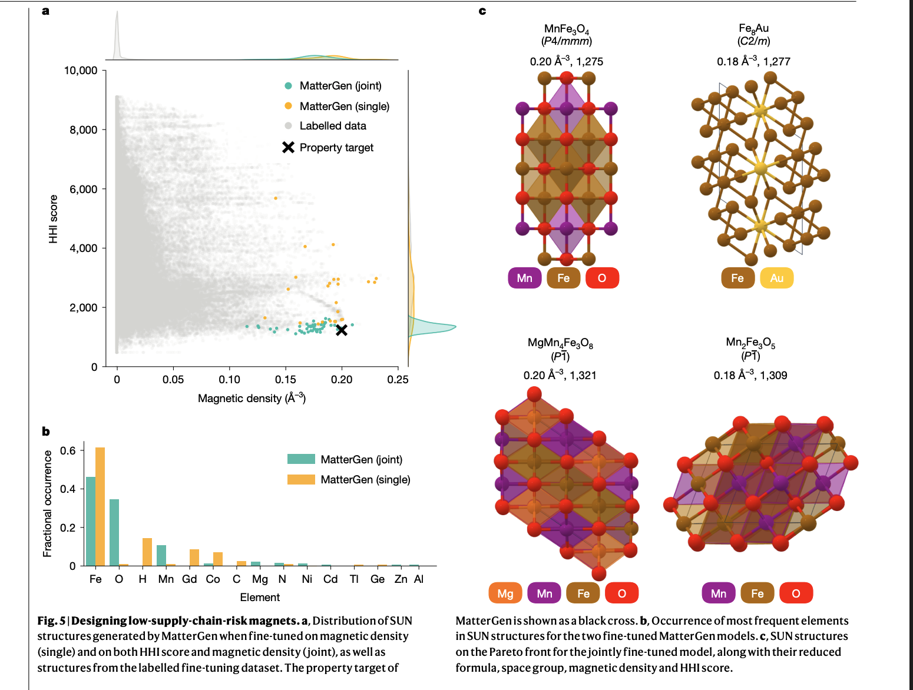
Generating new materials with Mattergen
Mattergen can be conditioned on target property values. E.g., new magnets with earth-abundant elements (low HHI score) and high magnetic density
Conditioning Mattergen on both HHI score and magnetic density at the same time gave best results
For this work, we will condition Mattergen on average Na voltage, chemical system, and energy above hull to target discovery of high voltage, stable materials in particular chemical systems, e.g,. Na-Mn-P-C-O
Zeni, C., et al. Nature 639 (2025). https://doi.org/10.1038/s41586-025-08628-5
Notes:
Note, “SUN” score is measure of stable, unique and new materials compared to those in known databases. S = 0.1 eV/atom, U= no matching structure in generation, N = no matching structure in database

Slide 4
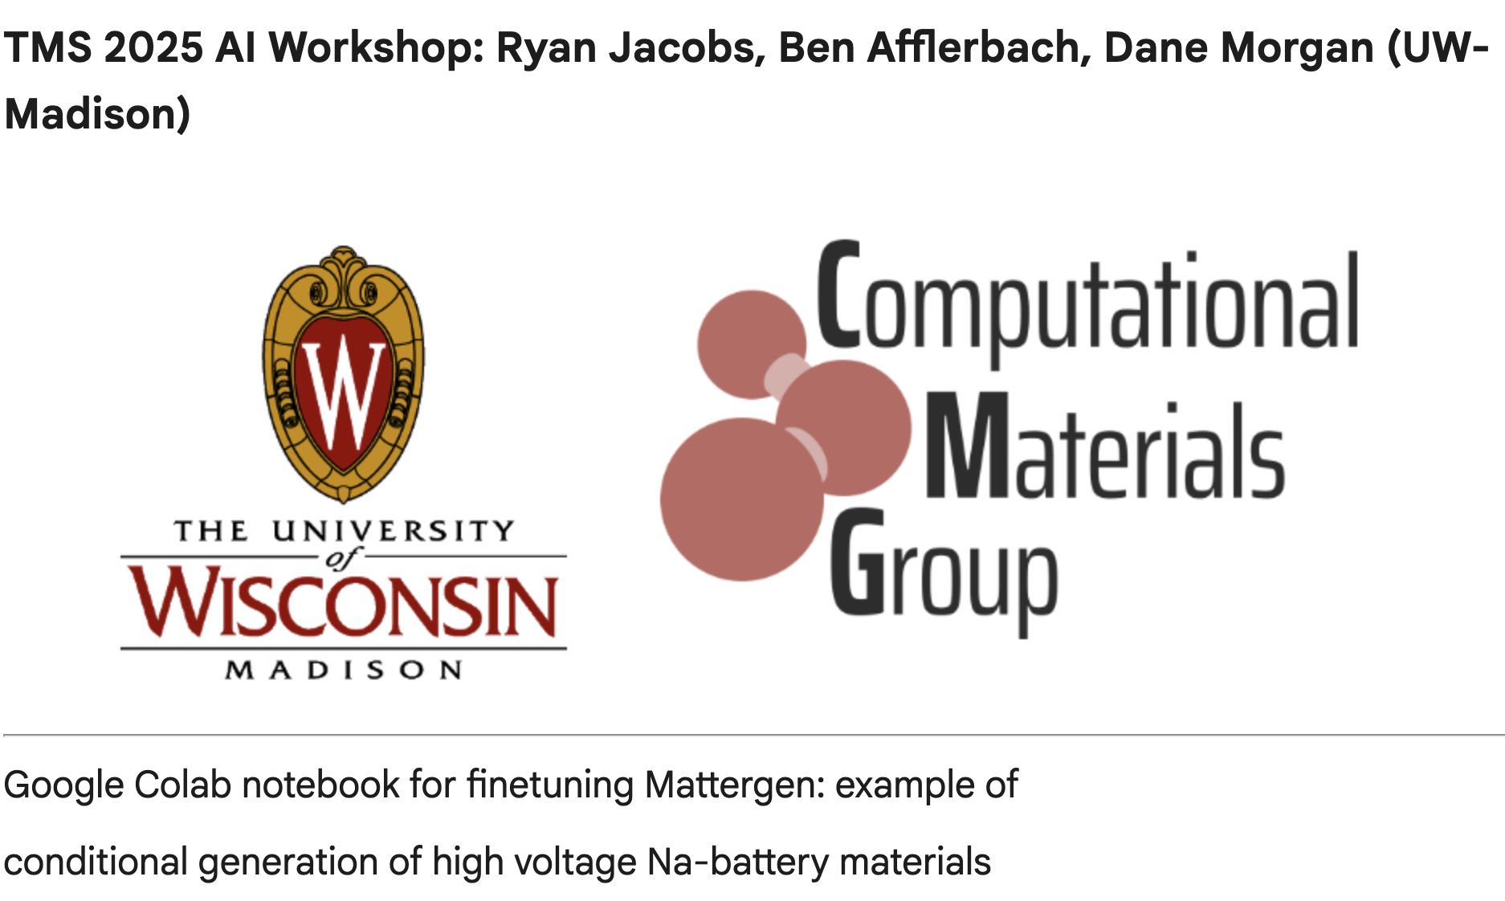

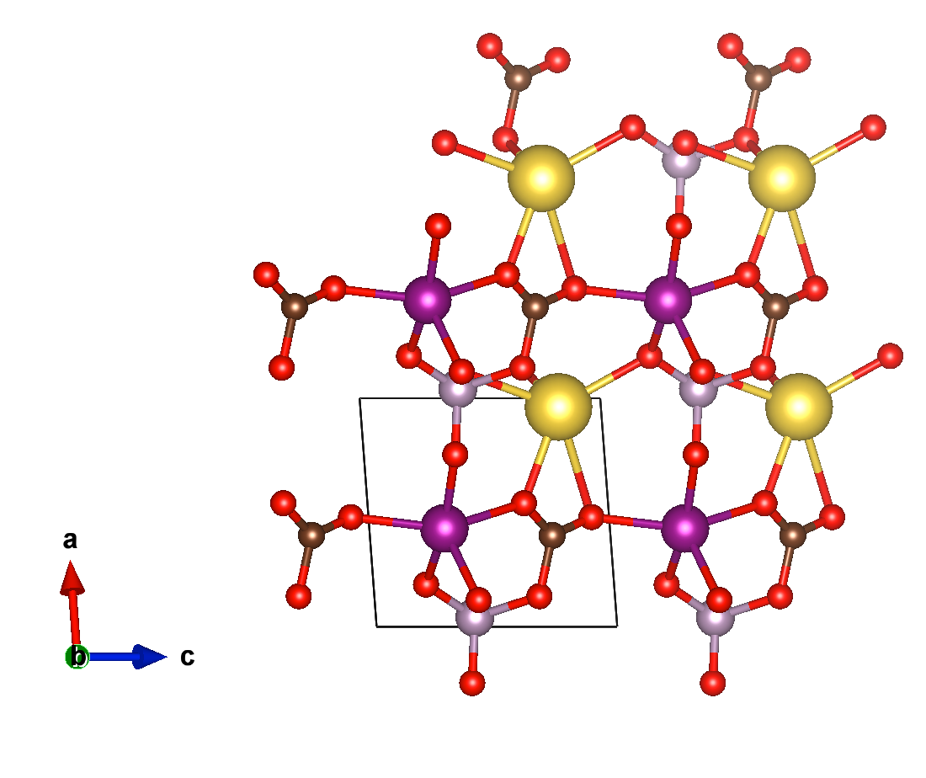
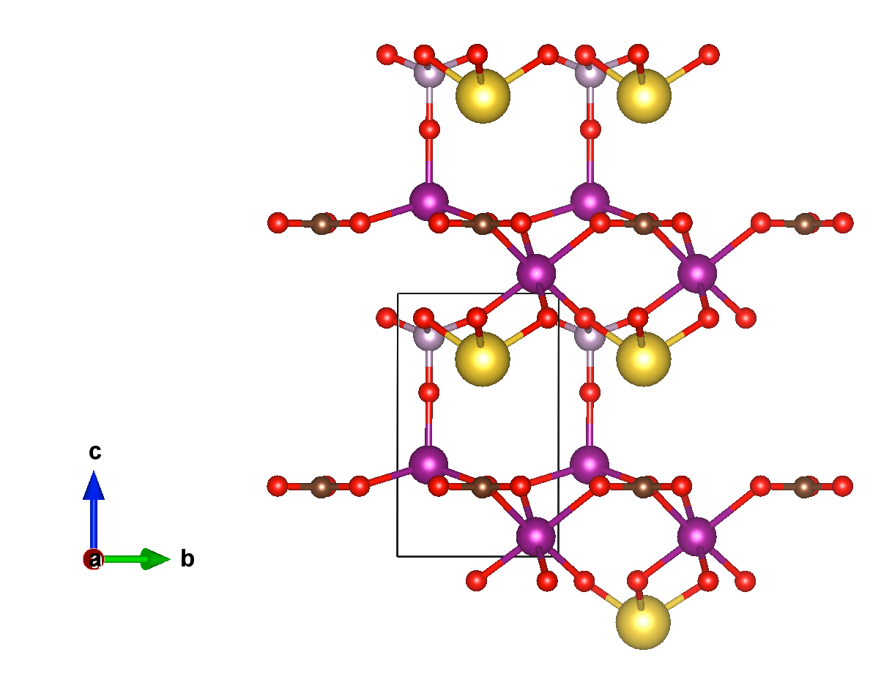
Mattergen Tutorial Notebook
Our Mattergen tutorial will equip you with the tools needed to finetune Mattergen on your own data and for your own property of interest
We will now move on to our lab activity, where we will do the following:
Fine-tune Mattergen using a database of UMLIP-calculated average voltages of prospective Na-cathode materials
Use our fine-tuned model to generate new potential materials in a prescribed composition space
Use a UMLIP (CHGNet) to calculate the energy of the discharged and charged state of a generated material and obtain its average voltage
Notes:
Note, “SUN” score is measure of stable, unique and new materials compared to those in known databases. S = 0.1 eV/atom, U= no matching structure in generation, N = no matching structure in database

